Slide 1

Monday 20th June
EYFS Curriculum Evening
ANKER VALLEY PRIMARY ACADEMY

Slide 2
Vision and Ethos
Our vision for Anker Valley Primary Academy is to work in close collaboration with parents, the local and wider community to inspire all to excellence. Pupils will reach the highest standards of achievement and personal success through engaging with a range of learning experiences that foster curiosity and capitalise on their unique talents.
Our ethos will reflect the values of the Fierté Trust: we care, we leave no one behind, we celebrate individuality and we are brave.
As a result, an Anker Valley pupil will stand out as a child who is compassionate, never gives up on others, takes their own opportunity but also allows others their moment to shine and relentlessly aspires to achieve more overcoming obstacles or setbacks.

Slide 3
Our Expectations
At Anker Valley, we are passionate about providing an education that meets the needs of all our children and families. We understand the importance of being ready to learn and how external and internal factors can impact upon a child's successes.
We have high expectations that all stakeholders will work together to provide the best possible opportunities that will enable our children to thrive in an ever-changing society.
It is our expectation that all stakeholders (parents, children and staff) will:
Be respectful
Show kindness
Be courteous
Be determined
Show care

Slide 4
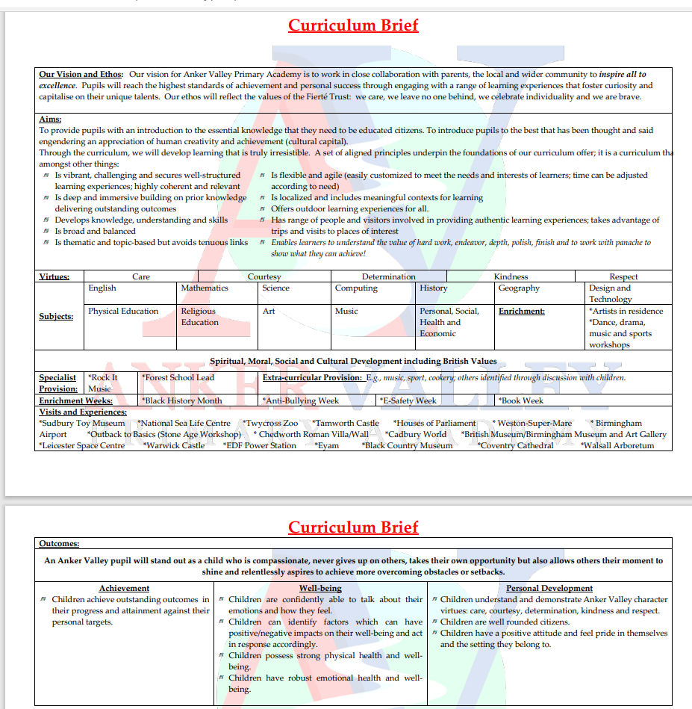
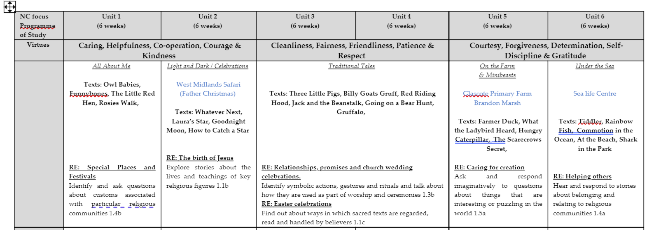
Anker Valley Curriculum
-National Curriculum
-Local area and influences
-Character Education and Virtues
-Diversity
-Enrichment (trips and visits)
-Will continue to grow, develop and adapt

Slide 5
Staffing for Dragonflies
Mrs Andrea Free –Class Teacher– Monday – Friday
Mrs Natalie Horlor – Head of School- Every morning and to cover PPA time on a Wednesday.
Miss Sarah Garrett – Teaching Assistant- Tuesday – Friday afternoon
Mrs Maria Hamblin – CEO of Trust and Executive Headteacher
Mrs Sam Lewis – Trust Wellbeing Lead – Based at Anker Valley one day a week.
Miss Heidi Elliot – Office Manager
Mrs Chyla – Cook

Slide 6

EYFS Curriculum
The Early Years Foundation Stage covers the first stage of a child’s care
from birth to five years old and has been revised with the new framework becoming statutory from September 2021.
There are seven areas of learning in the EYFS.
Prime areas:
Communication and Language
Personal, Social and Emotional Development
Physical Development
Specific areas:
Literacy
Mathematics
Understanding the World
Expressive Arts and Design

Slide 7
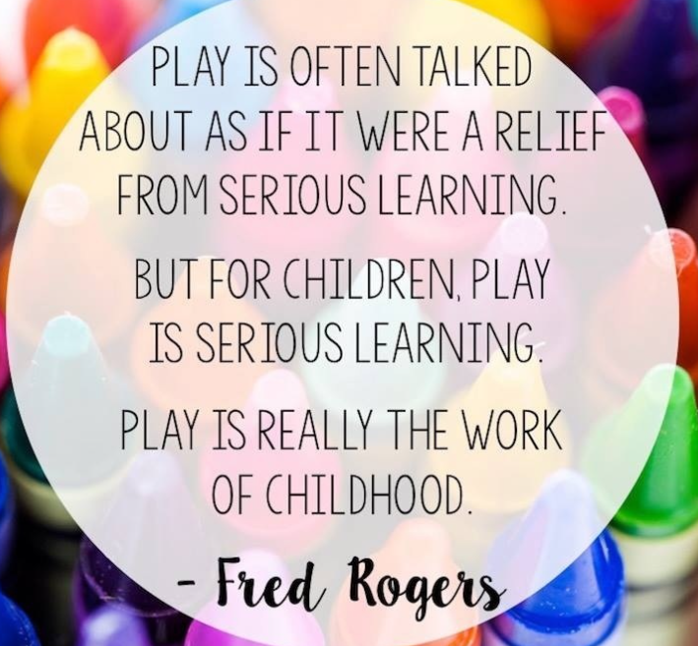

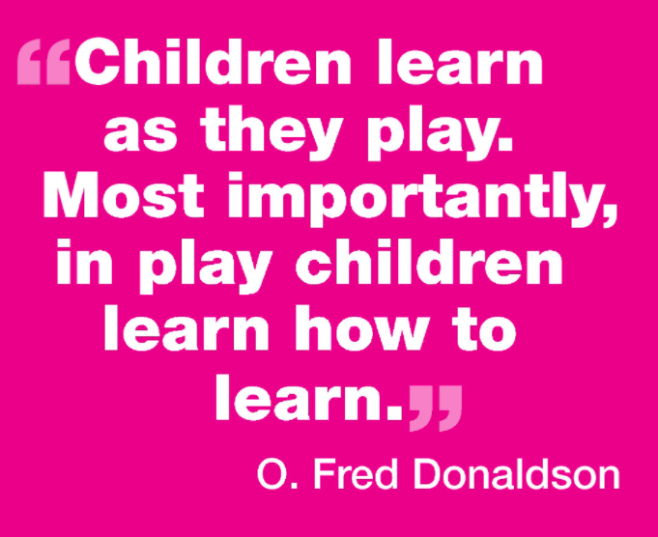
EYFS Curriculum - Play
‘Today, I just played…’
Play based learning allows the children the opportunity to:
Revisit
Rehearse
Consolidate
Be creative
Be inquisitive
Build relationships

Slide 8
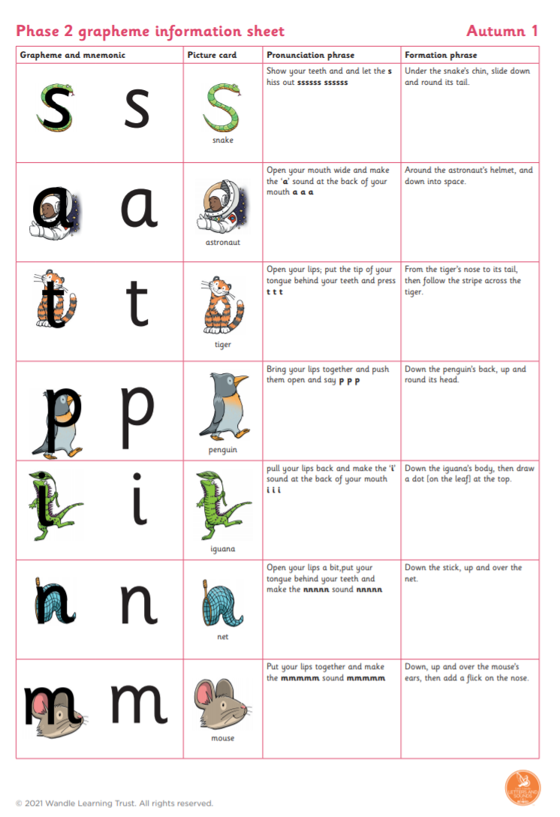

EYFS Curriculum – Phonics
Little Wandle Letters and Sounds programme
We will hold Phonics Workshops in the autumn term, more details to follow.

Slide 9
EYFS Curriculum –Reading
Reading in Dragonflies:
Three sessions a week in school
Weekly visit to the school library and Tamworth Library fortnightly
Reading books and reading diaries
Never read to | Read to 1-2 times per week | Read to 3-5 times per week | Read to daily | Read 5 books a day
4,662 words | 63,570 words | 169,520 words | 296,660 words | 1,483,300 words
Taken from the DfE document ‘The reading framework Teaching the foundations of literacy July 2021’; based on research completed and published in Science Daily.

Slide 10
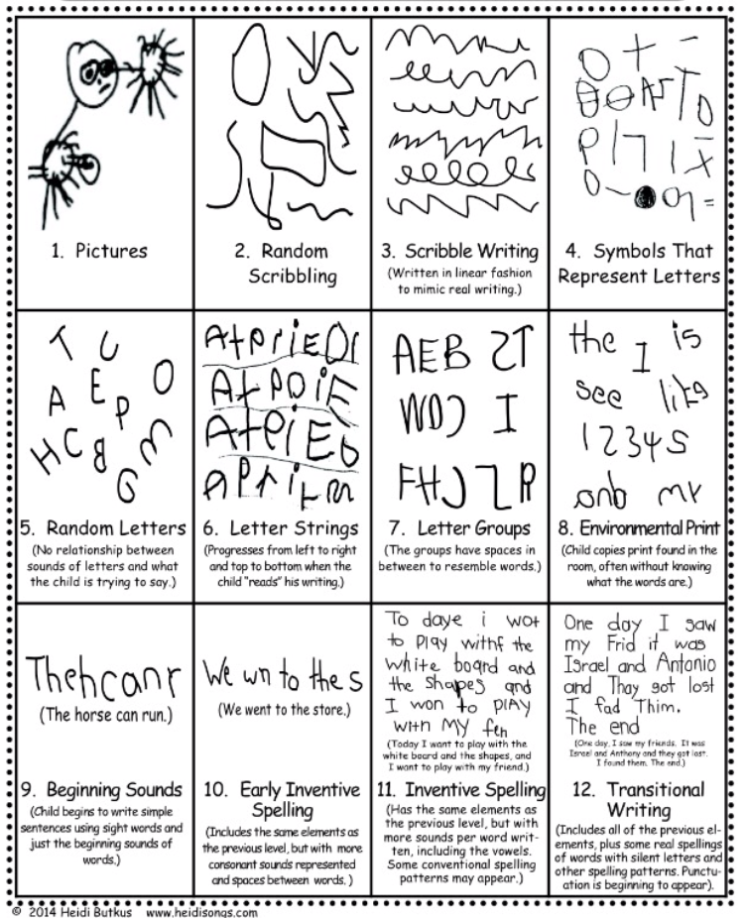


EYFS Curriculum –Writing

Slide 11
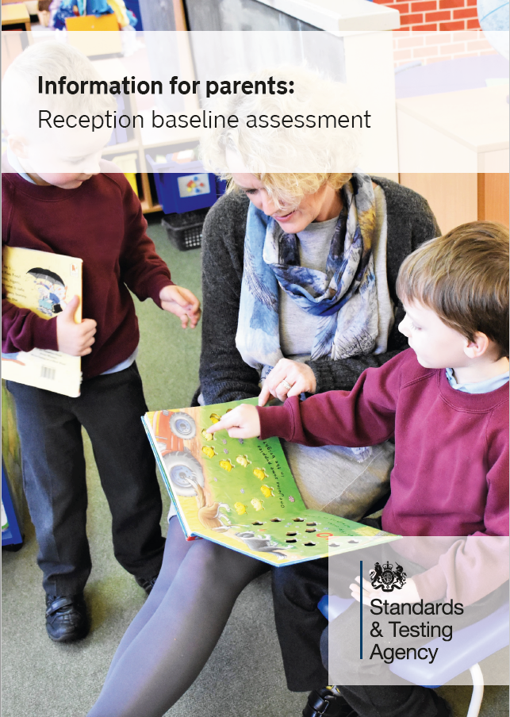
Reception Baseline Assessment
A short one-to-one session during the first six weeks of starting school.
Activity- based assessment of pupils' starting points in:
language, communication and literacy
mathematics
There will be no need for pupils to prepare for the assessment.
Autumn term parent consultation meetings will then be a chance to share information from the initial assessment.
More information on our website and in the Information for parents: Reception baseline assessment leaflet.

Slide 12

What can I do to help prepare my child for starting school?
Develop their independent skills e.g. toileting, washing hands, getting dressed and undressed, using a tissue and using a knife and fork.
Read and share stories together with your child to foster a love of reading and develop your child’s vocabulary.
Play games with your child where they need to take turns and share.
Help your child to recognise their own name when it is written down. Children do not need to be able to write their name before they start school.
Sing Nursery Rhymes together.
Encourage your child to talk about their feelings/emotions and to ask for help when necessary.
Talk about starting school with them.
Share any relevant information with us to enable us to further
support your child with starting school.

Slide 13

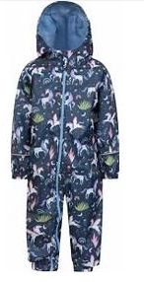
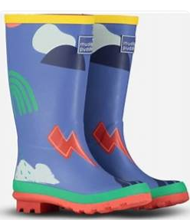

What does my child need at school?
Puddle suit – to be named and left in school.
Wellies – to be named and left in school.
Book bag (not a back pack) – please bring everyday with reading books and reading diaries inside so that any reading in school can be recorded and books changed regularly.
Water bottle – please bring everyday.
PE Kit – to be left in school.
Please make sure all uniform and belongings are named.

Slide 14
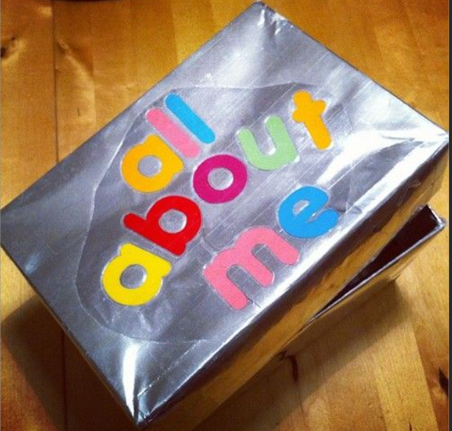
Summer Challenge - All About Me Box!
Using an empty shoe box, can your child decorate the box and inside place items or photographs to share information about their interests and their family.
Completed boxes to be in school by Friday 9th September 2022
These boxes will then be shared in class and returned.

Slide 15
The School Day (Reception)
8:45am – Gates Open (Walk to the rear of the building to classroom)
8.55am – Gates Close
9:00am – Register Taken
9.15 -11.30am- Child Led Learning Opportunities and Adult Directed Tasks
11.30am -12.00pm – Phonics
12:00pm – 1:00pm - Lunch Time
1.00-3.00pm- Child Led Learning Opportunities and Adult Directed Tasks
3.00pm – Storytime
3:30pm – Home Time (Gates will open at 3:15pm and children released to parent at 3:30pm)
NB. If somebody different is collecting please notify Mrs Free / Mrs Horlor
Parking

Slide 16
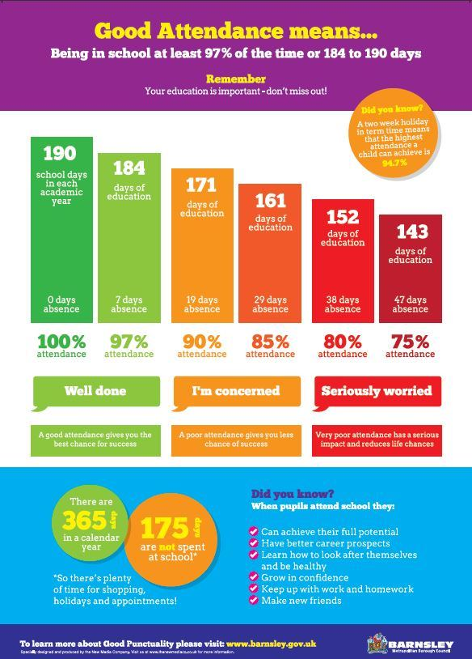
Attendance, Punctuality and Holidays – Sam Lewis

Slide 17
School Uniform
Our uniform is:
A red Anker Valley sweatshirt or cardigan;
White shirt/blouse;
Red and silver striped tie;
Pale grey culottes, pinafores, skirts, shorts or trousers;
Pale grey tights or white/ pale grey socks;
Black school shoes- no logos.
Please note our expectation will be that children will not wear trainers, boots, or coloured shoes.
Our PE Kit is:
An Anker Valley Primary black PE T-shirt;
Black shorts - plain;
Black PE footwear (trainers or plimsolls) suitable for both indoor activities and outdoor;
Red PE bag- drawstring.

Slide 18
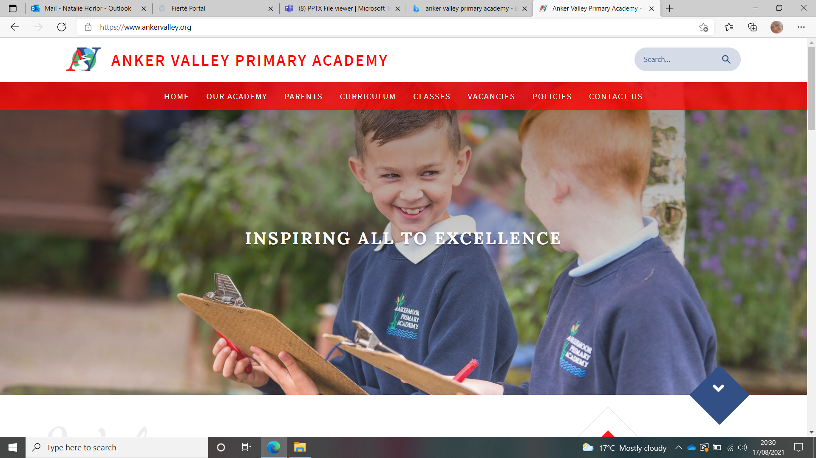

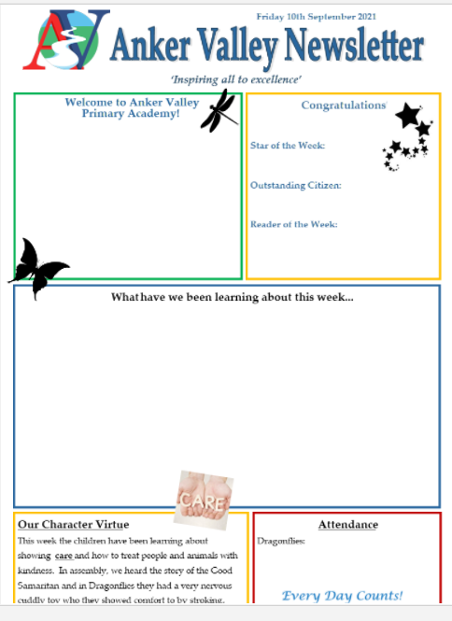

Website
-Term Dates
-Uniform (expectations)
-Copies of Newsletters
-Class Pages
Newsletter
-Emailed weekly
-Reminders of dates
-Learning that has taken place
-Stars of the week
Parents Evenings, Workshops, Assemblies, End of Year Reports.

Slide 19



Parent Portal
- Check Data held by school
-Receive newsletters and other letters
-View attendance
Parent Pay
-Payments for trips
-Dinner Money Payment
-Cashless
Tapestry (EYFS)
-Share children's achievements and learning experiences at home and in school

